Slide 1


SMART INDIA HACKATHON 2024
Introduction
Problem Statement ID : 1673
Problem Statement Title: Farmers Disease Diagnostic/Reporting Portal - Mobile Portal Al Based
Theme: Agriculture, FoodTech & Rural Development
PS Category: Software
Team ID- GUSIH135
Team Name – AgroVision

Slide 2
MOMENTUM TO AGRICULCUTRE (Productivity and Food Security)
Team
AGRO VISION
Detailed explanation of the proposed solution
AI increases the accuracy level of detecting the deficiency in the plant and disease in animal.
Chat box help the farmer to share their problem and acquire the better solution.
Finance will store the seasonal records of farmer and help in better understanding of there expenditure and profit earn.
AI will help the farmer in better decision making and understanding of the problem.
Innovation And Uniqueness Are:-
We Have create AI Detector Tool which have detect the problems of the plants such as (wheat, Rice, And Some other kind of Herbs etc.) and health of the animals such as ()It Also helps for predict the upcoming plant disease which also help to protect the crop fields.
We have created a platform for direct connection from farmer to consumer without interference of any broker. It improve the farmers life quality and security.

Slide 3









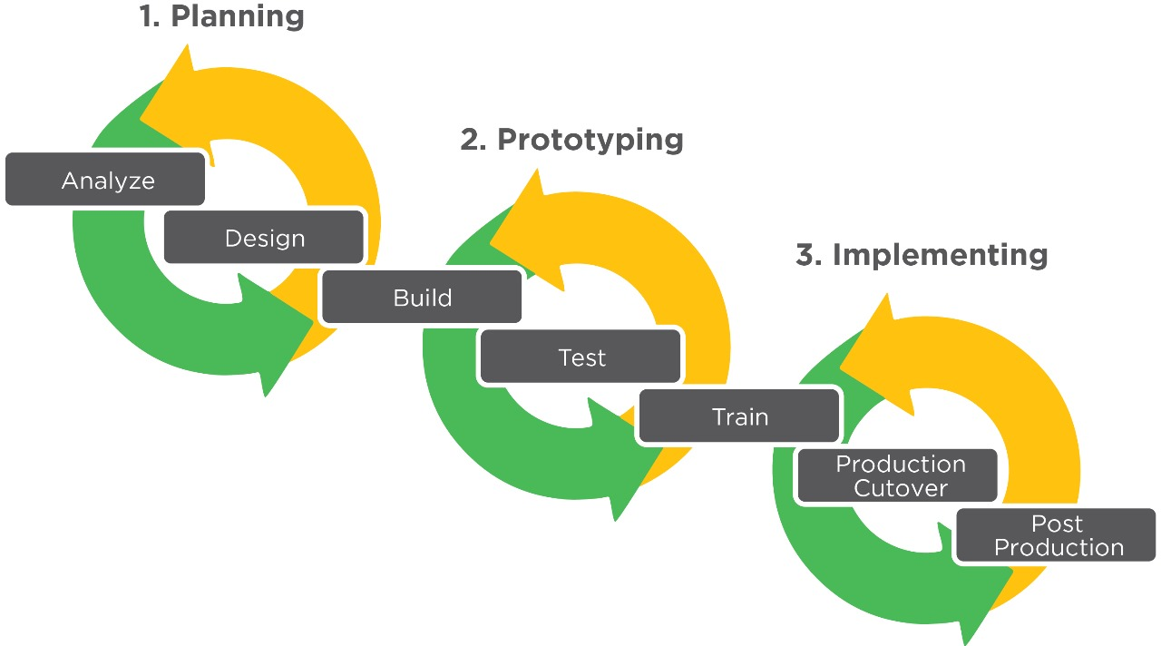
TECHNICAL APPROACH
Team
AGRO VISION
Technologies to be used are:- AI-Driven Decision Support Systems, Natural Language Processing (NLP), and the languages are:-
HTML CSS React JavaScript Python SQL PHP Kotlin Java
Methodology and process for implementation:-
A website for farmers to solve the crop fields problem in real life with the help of Programming languages, Database, Frameworks and Inbuilt Artificial Intelligence.

Slide 4
FEASIBILITY AND VIABILITY
Analysis of the feasibility of the idea:-
Farmers: Small-scale to large-scale farmers in various regions.
Consumers: Individuals interested in sustainable food and local produce.
User-friendly Interface: Easy navigation and intuitive design.
Strategies for overcoming these challenges:-
Challenge: Farmers may not be familiar with how to use AI tools effectively.
Strategy: Implement farmer training programs focused on the use of AI, data collection, and smart farming techniques. This can be done through community workshops, agricultural extension services, or even interactive online tutorials. Partnering with local institutions and NGOs to provide continuous support can help build trust and familiarity.
Challenge: Farmers may be hesitant to fully trust new technologies over their traditional practices.
Strategy: Develop AI tools that integrate well with traditional farming methods. Use AI to enhance, not replace, the farmer’s knowledge. For example, AI tools could assist farmers in recognizing patterns they already know and give additional insights.
Challenge: Farmers need quick, real-time responses to make decisions in rapidly changing conditions.
Strategy: Design AI systems that offer real-time analysis and feedback, allowing farmers to address issues like pest infestations or nutrient deficiencies as they arise. Implement user-friendly interfaces that provide immediate solutions or advice when a crop is scanned.
Team
AGRO VISION

Slide 5
IMPACT AND BENEFITS
Team
AGRO VISION
Potential Impact On The Target Audience Is:-
Enhanced Decision-Making
Increased Efficiency
User Experience
Benefits Of The Social, Economic, Environmental Is:-
Social Benefits-
Educational Aspect
Technological Development
Make Farmer More Sustaniable
Economic Benefits-
Increased Productivity
Social Farming
Market Access
Environmental Benefits:-
Resource Efficiency
Waste Reduction
Lower Carbon Footprint
Improve Crop and Animal Health

Slide 6






RESEARCH AND REFERENCES
Team
AGRO VISION
We are researching on the crop disease and soil problems which impact on the plant. and On field data analysis and using some ai tools, website, & some images to train the inbuilt website AI. Which helps to built our website fast and responsive.
TOOLS & LINKS ARE:-
ChatGpt
GeeksForGeeks
IIL
Printrest
Wikipidea
NMSA

